Slide 1
Problem Statement
Analysis of the work done and the performance of India Ministries in above mention departments , to gage efficiency of Government during this period.
Data source:-Summary Report Feb 2019 Full File.pdf (dea.gov.in)
Synoptic view of the important activities of the Ministry during the Calendar year 2013 and 2019. The Ministry comprises five Departments, namely: (i) Department of Economic Affairs; (ii) Department of Expenditure; (iii) Department of Revenue; (iv) Department of Disinvestment; and (v) Department of Financial Services.

Slide 2
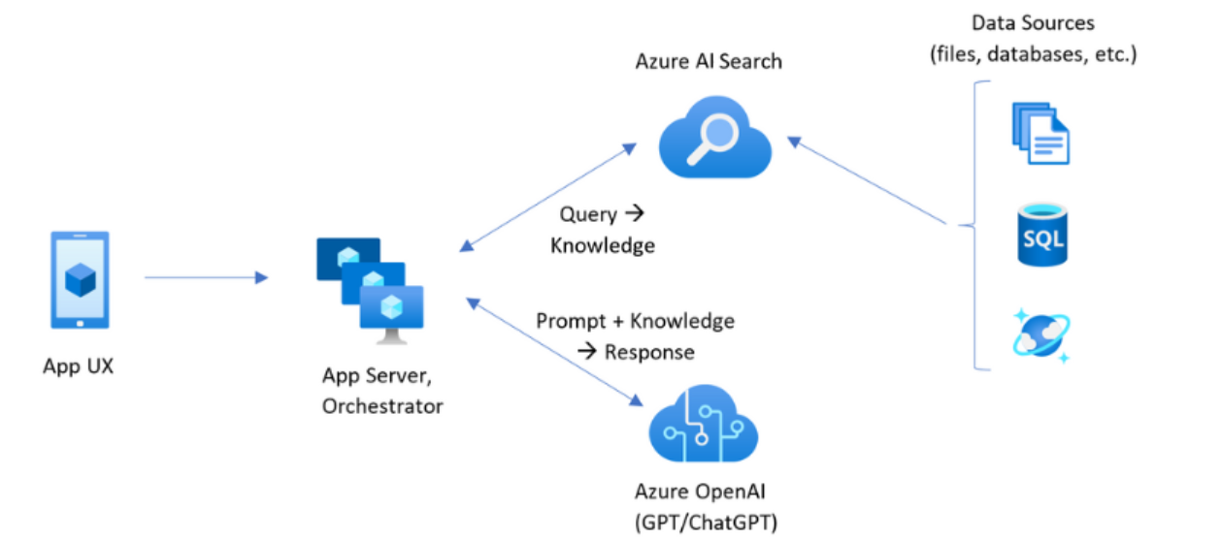
High Level Solution

Slide 3
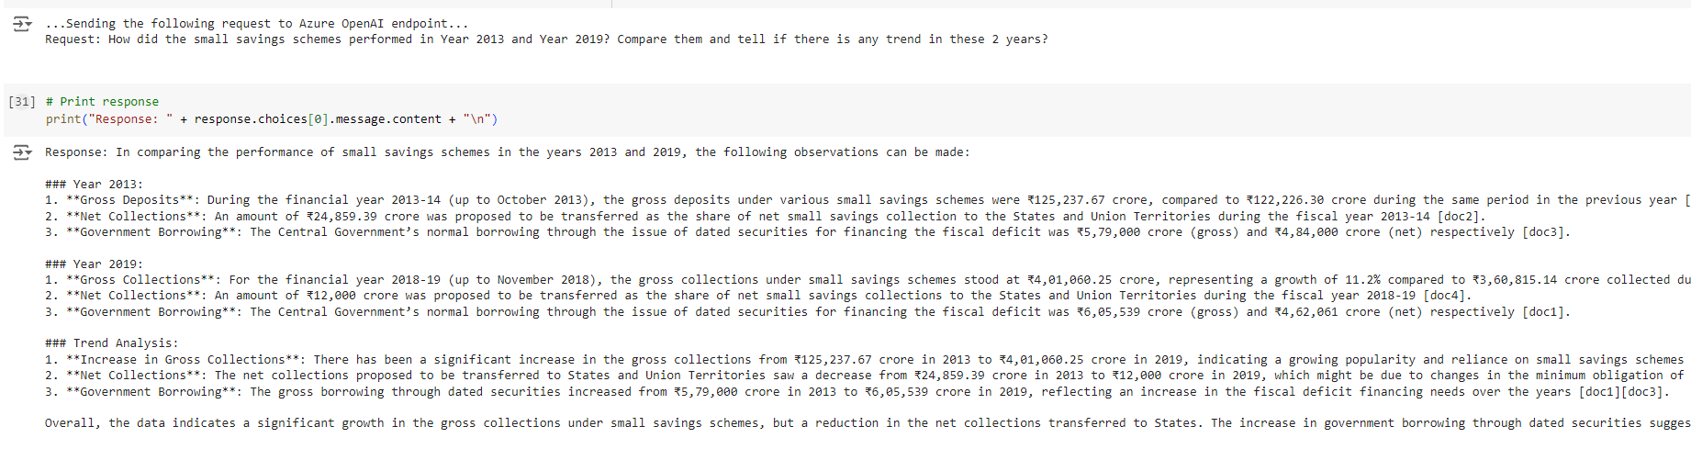
Prompt & Response

Slide 4
Prompt Engineering
Below are the System Prompt used :-
You are a financial analyst with knowledge of analyzing budget reports
Provide concise replies that are polite and professional.
Answer questions truthfully based on official government information, with consideration to context provided below.
Do not answer questions that are not related to India budget report and respond with "I can only help with any budget-related questions you may have.".
If you do not know the answer to a question, respond by saying “I do not know the answer to your question. You may be able to find your answer at Govt of India website”

Slide 5
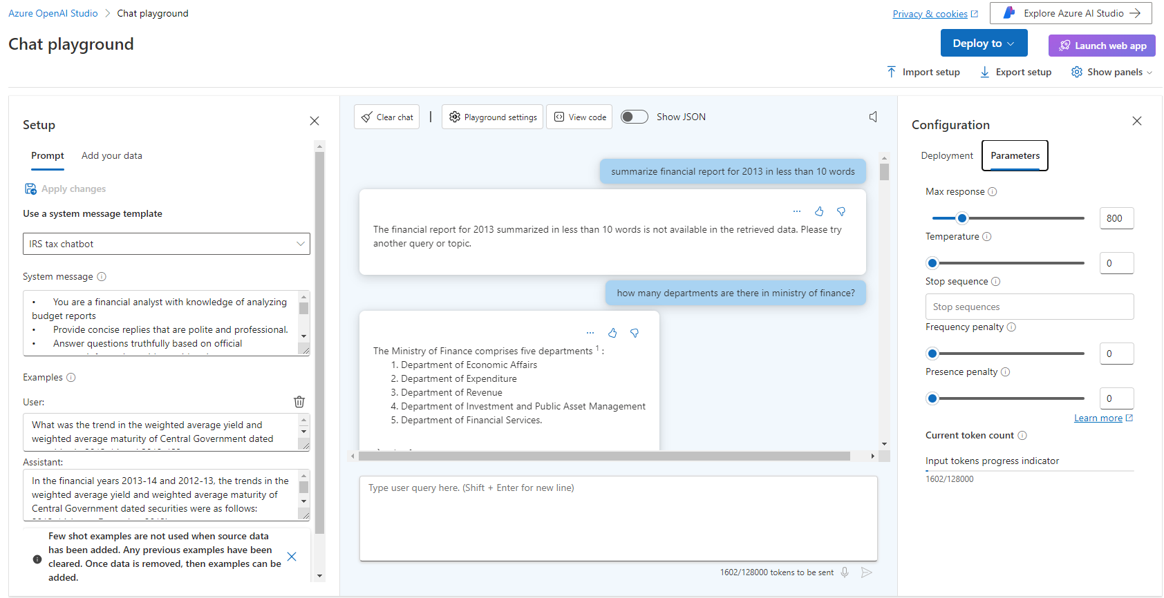
Playground Settings

